Slide 1
CS 211 Computer Architecture Lecture 35: Memory Hierarchy and Cache Memory
Ravi Mittal
ravi.mittal@iitgoa.ac.in
Indian Institute of Technology, Goa

Slide 2
References and Acknowledgements
Krste Asanović & Randy H. Katz, CS 61C: Great Ideas in Computer Architecture (Machine Structures), http://inst.eecs.berkeley.edu/~cs61c/
Chapter 6, Memory Hierarchy, Book: Computer Systems: A programmer’s perspective, Randal E. Bryant and David R. O’Hallaron
MIT Course 6.004 Computation Structures, Spring 2020, Lecture on Cache
Book: Digital Design and Computer Architecture: RISC-V Edition, Harris & Harris Elsevier

Slide 3
Review

Slide 4
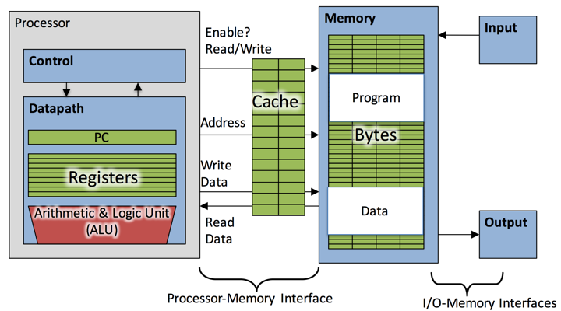
Ref: Krste Asanović & Randy H. Katz, Univ of California, Berkeley

Slide 5
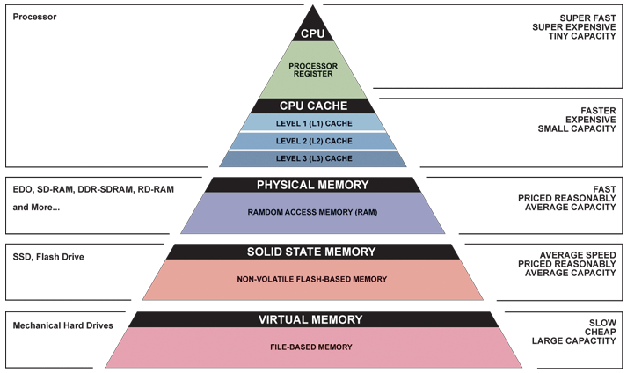
Great Idea: Principle of Locality/Memory Hierarchy
Ref: Krste Asanović & Randy H. Katz, Univ of California, Berkeley

Slide 6
In this class we will study
Cache Memory Concept
Principle of Locality
Memory Hierarchy to Exploit locality
Memory Access using Cache

Slide 7
Kilo, Mega, Giga, Tera, Peta, Exa, Zetta, Yotta
Common use prefixes (all SI, except K [= k in SI])
Confusing! Common usage of “kilobyte” means 1024 bytes, but the “correct” SI value is 1000 bytes
Hard Disk manufacturers & Telecommunications are the only computing groups that use SI factors
What is advertised as a 1 TB drive actually holds about 90% of what you expect
A 1 Mbit/s connection transfers 10⁶ bits per second

Slide 8
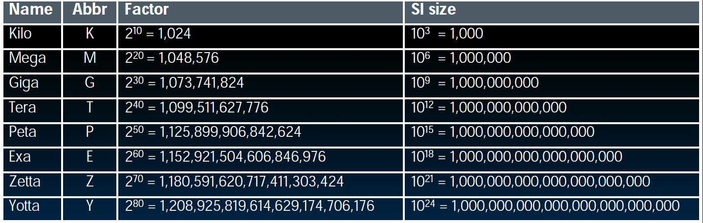
Kilo, Mega, Giga, Tera, Peta, Exa, Zetta, Yotta

Slide 9
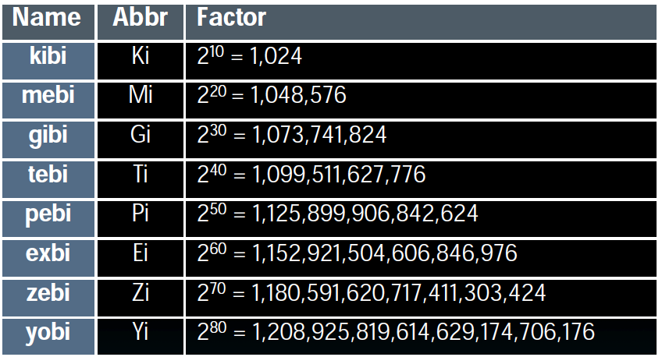
Kilo, Mega, Giga, Tera, Peta, Exa, Zetta, Yotta
International Electrotechnical Commission (IEC) in 1999 introduced these to specify binary quantities
Names come from shortened versions of the original SI prefixes (same pronunciation) and bi is short for “binary”, but pronounced “bee” :-(
Now SI prefixes only have their base-10 meaning and never have a base-2 meaning

Slide 10
Cache Memory - Concept

Slide 11
Memory Performance
Memory Speed ?
Latency
Throughput
Latency
Latency is the time to access the first byte of information
Throughput
The number of bytes per second that can be delivered
Ideally memories should have low latency and high throughput

Slide 12
Storage in a Computer
Processor
Holds data in register files (~ 100 Bytes)
Registers accessed on sub-nanosecond timescale
Memory (“main memory”)
Significantly more capacity than registers (~ GiB) – say 8 GiB
Access time ~ 50-100 ns
DRAM memory is 10-100 times slower than processor – in terms of speed (execution time for processor vs access time for the Main Memory)
DRAM throughput is good: 30
Hundreds of clock cycles per memory access
Would CPU wait for so long (say 500 cycles) to get data from memory?
It will be very slow computation

Slide 13
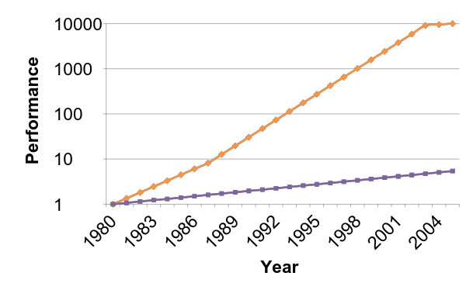
Processor-Memory Speed Gap
1989 first Intel CPU with cache on chip
1998 Pentium III has two cache levels on chip
µProc
55%/year
(2X/1.5yr)
Processor-Memory
Performance Gap (grows 50%/year)
“Moore’s Law”
DRAM Speed
7%/year
(2X/10yrs)
Ref: Krste Asanović & Randy H. Katz, Univ of California, Berkeley

Slide 14
Processor-Memory Speed
DRAM could keep up with processors in the 1970s
By early 80’s memories become way too slow compared to processors
2005 -2010: Multicore systems further worsen the gap between processor and memory speeds

Slide 15
DRAM
Ref: Krste Asanović & Randy H. Katz, Univ of California, Berkeley

Slide 16
Library Analogy
Writing a report on a specific topic
e.g. history of the computer (your internet is out)
While at library, take books from shelves and put them on shelf above your desk
If need more, go get them and bring back to shelf
Don’t return earlier books since might still need them
Limited space on shelf; which books do we keep?
You hope these ~10 books on shelf enough to write report
Only 0.00001% of the books in a big library
Ref: Krste Asanović & Randy H. Katz, Univ of California, Berkeley
Notes:
main stax -> shelf -> desk
Some text explaining
change pix

Slide 17




Ref: Krste Asanović & Randy H. Katz, Univ of California, Berkeley

Slide 18
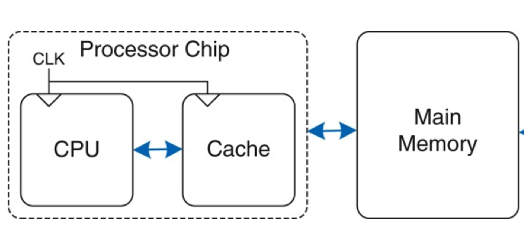
Introducing Cache Memory
Ref: Book – Harris and Harris

Slide 19
Principle of Locality

Slide 20
Principle of Locality (1/3)
Principle of Locality:
Programs access only a small portion of the full address space at any instant of time (spatial locality) and repeatedly access that portion (temporal locality)
Address space holds both code and data
A “typical” program has a lot of locality in memory references
Typical programs are composed of “loops”
Loops and sequential instruction execution mean generally localized code access
Ref: Krste Asanović & Randy H. Katz, Univ of California, Berkeley

Slide 21
Principle of Locality (2/3)
Temporal Locality (locality in time)
Go back to the same book on desk multiple times
If a memory location is referenced then it will tend to be referenced again soon
Spatial Locality (locality in space)
When go to shelves, grab many books on computers since related books are stored together
If a memory location is referenced, the locations with nearby addresses will tend to be referenced soon
Most notable examples:
Instruction memory references
Array/data structure references
Ref: Krste Asanović & Randy H. Katz, Univ of California, Berkeley

Slide 22
Memory Locality
Temporal:
Spatial:
Bryant and O’Hallaron, Computer Systems: A Programmer’s Perspective, Third Edition

Slide 23
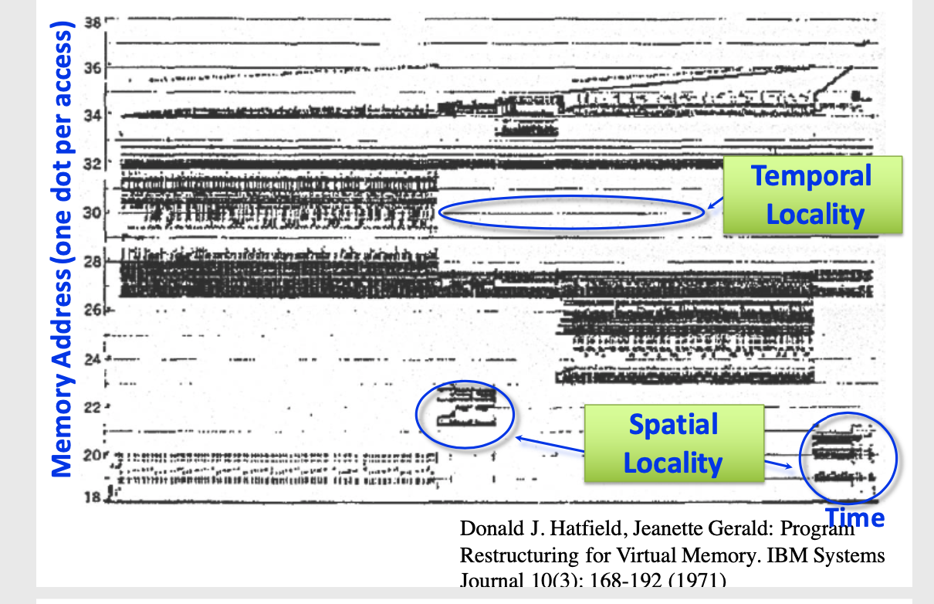
Memory Reference Patterns
Ref: Krste Asanović & Randy H. Katz, Univ of California, Berkeley

Slide 24
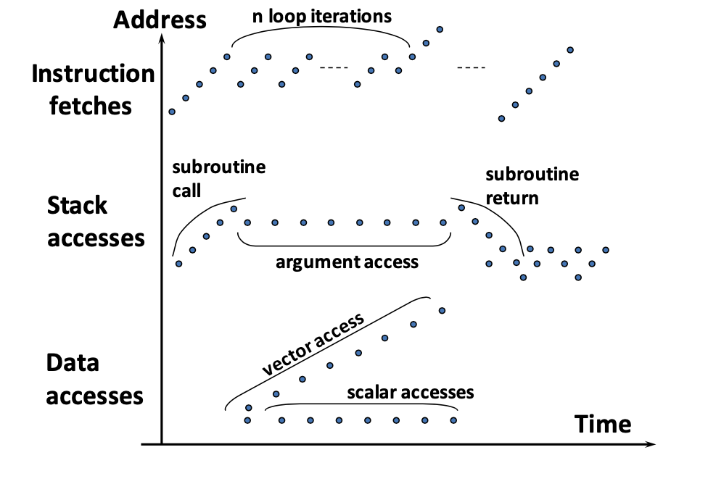
Memory Reference Patterns
Ref: Krste Asanović & Randy H. Katz, Univ of California, Berkeley

Slide 25
Locality Example
sum = 0;
for (i = 0; i < n; i++)
sum += a[i];
return sum;
Spatial or Temporal
Locality?
Data references
Reference array elements in succession (stride-1 reference pattern).
Reference variable sum each iteration.
Instruction references
Reference instructions in sequence.
Cycle through loop repeatedly.
spatial
temporal
spatial
temporal
Bryant and O’Hallaron, Computer Systems: A Programmer’s Perspective, Third Edition

Slide 26
Principle of Locality (3/3)
We exploit the principle of locality in hardware via a memory hierarchy where:
Levels closer to processor are faster (and more expensive per bit - hence smaller)
Levels farther from processor are larger (and less expensive per bit - hence slower)
Goal: Create the illusion of memory being almost as fast as fastest memory and almost as large as biggest memory of the hierarchy
Ref: Krste Asanović & Randy H. Katz, Univ of California, Berkeley
Notes:
Mention that making fast and efficient small hardware is more expensive than bigger, slower hardware

Slide 27
Memory Hierarchy to Exploit Locality

Slide 28
Memory Hierarchy Schematic
Processor
Level 1
Smaller,
Faster, More expensive
Level 2
Lower Higher
Level 3
. . .
Bigger,
Slower, Cheaper
Level n
Ref: Krste Asanović & Randy H. Katz, Univ of California, Berkeley
Notes:
The Processor accesses data out of the highest levels.
Lowest level (usually disk) contains all available data.

Slide 29
Memory Cache Concept
Cache holds a copy of a subset of main memory
We often use $ (“cash”) to abbreviate cache (e.g. D$ = Data Cache, L1$ = Level 1 Cache)
Keep recently accessed data in automatically managed fast memory
Anticipation: the data will be accessed again soon
Cache is
SRAM
Implemented with same IC processing technology as CPU
Integrated on-chip
On-chip memory eliminates lengthy delays caused by traveling to and from a separate chip
The cache speed is comparable to the processor speed
It is faster but more expensive than main memory (DRAM)
Ref: Krste Asanović & Randy H. Katz, Univ of California, Berkeley

Slide 30
Memory Transfer in the Hierarchy
Processor
4-8 bytes (word)
Inclusive: data in L1$ ⊂ data in L2$ ⊂ data in MM ⊂ data in SM
L1$
Block: Unit of transfer between main memory and cache; Also between Caches
L2$
8-32 bytes (block)
16-128 bytes (block)
Main Memory
4,096+ bytes (page)
Secondary Memory
Ref: Krste Asanović & Randy H. Katz, Univ of California, Berkeley
Notes:
Symbol ⊂ means “is a subset of”

Slide 31
The Problem
Bigger is slower
SRAM, 1 MB-16MB, 0.5 nanosec
DRAM, 1 GB – 16 GB 10- 50 nanosec
Hard Disk, Terabyte, ~5000000 nanosec
Faster is more expensive (dollars and chip area)
SRAM, < 100$ per Giga Byte
DRAM, < 10$ per Giga Byte
Hard Disk < 0.05 per Giga Byte
These sample values (circa ~2020) scale with time
Other technologies are evolving, too
Flash memory (mature)

Slide 32
Memory Hierarchy Technologies
Caches use static RAM (SRAM)
Fast (typical access times of 0.5 ns)
Higher power, expensive
Static: content will last as long as power is on
Main memory uses dynamic RAM (DRAM)
Lower power, cheaper
Slower (typical access times of 10- 50 ns)
Dynamic: needs to be “refreshed” regularly (~ every 8 ms)
Ref: Krste Asanović & Randy H. Katz, Univ of California, Berkeley
Notes:
In case you didn’t know, RAM stands for Random Access Memory.
Size comparison: DRAM/SRAM is 4 to 8 times
Cost/cycle time comparison SRAM/DRAM is 8 to 16 times
http://parts.digikey.com/1/parts/1211303-ic-sram-1mbit-10ns-32soj-cy7c109d-10vxi.html
Quantity discount 10ns 1MBit SRAM $2.24, $17/Mbyte, $1700/100 Mbyte, $17000/GByte
http://www.frys.com/template/harddrives
DRAM: 4GB @ $70 or $17.50 per GB
24GB@$800 = $33/Gbyte
http://www.frys.com/category/Outpost/Hard+Drives+&+Memory/Memory/Notebook+Memory/Apple+-+Mac++Memory/
DDR2 1GB @ $25 per
DDR3 1 GB @ $37.5 per
FLASH Media
Approx. $2 per Gbyte

Slide 33
A Typical Memory Hierarchy (1/2)
On-Chip Components
Secondary
Memory
(Disk
or Flash)
Control
Datapath
Main
Memory
(DRAM)
Instr
Cache
Second
Level
Cache
(SRAM)
RegFile
Data
Cache
Speed: ½’s 1’s 10’s 100’s 1,000,000’s
(cycles)
Size: 100’s 10K’s M’s G’s T’s
(bytes)
lowest
Cost/bit: highest
Ref: Krste Asanović & Randy H. Katz, Univ of California, Berkeley

Slide 34
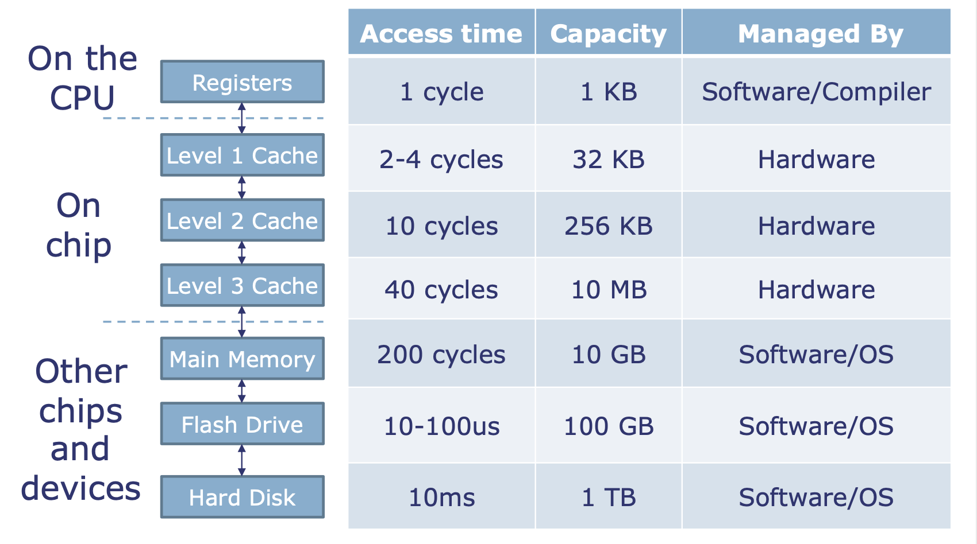
A Typical Memory Hierarchy (2/2)
Ref: MIT Course 6.004 Computation Structures

Slide 35
So, what is the difference between 3 levels of Caches?
Capacity: L1: 32KB L2: 256KB L3: 10 MB
Speed: L1: 2-4 Cycles L2: 10 Cycles L3: 40 Cycles
What else? Why different speeds (access time)?
Technology is different !
Size is different. Small memory is faster
L1 is made from larger transistors and wider metal tracks
→ Higher speed, but more space and power

Slide 36
Example Memory Hierarchy
L0:
Regs
CPU registers hold words retrieved from the L1 cache.
Smaller,
faster,
and
costlier
(per byte)
storage
devices
L1:
L1 cache
(SRAM)
L1 cache holds cache lines (blocks) retrieved from the L2 cache.
L2:
L2 cache
(SRAM)
L2 cache holds cache lines
retrieved from L3 cache.
L3:
L3 cache
(SRAM)
L3 cache holds cache lines
retrieved from main memory.
Larger,
slower,
and
cheaper
(per byte)
storage
devices
L4:
Main memory
(DRAM)
Main memory holds disk blocks retrieved from local disks.
L5:
Local secondary storage
(local disks)
Local disks hold files retrieved from disks
on remote servers.
L6:
Remote secondary storage
(e.g., Web servers)

Slide 37
Memory Access using Cache

Slide 38
Who manages transfers?
Registers ↔ Memory
By compiler (or assembly level programmer)
Cache ↔ Main memory
By the cache controller hardware
Main memory ↔ Disks (secondary storage)
By the OS (virtual memory, which is a later topic)
Virtual to physical address mapping assisted by the hardware (TLB)
By the programmer (files)
We are here
Ref: Krste Asanović & Randy H. Katz, Univ of California, Berkeley

Slide 39
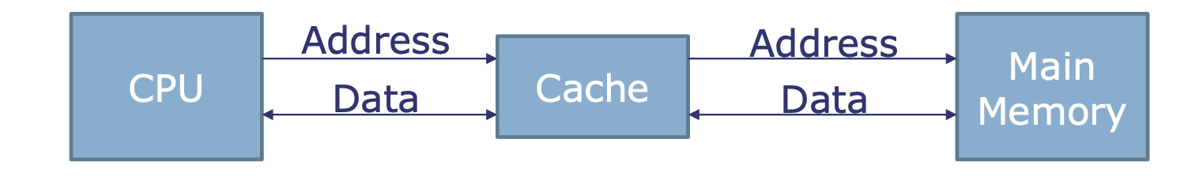
Cache Philosophy (1/2)
Programmer-invisible hardware mechanism to give illusion of speed of fastest memory with size of largest memory
Works fine (mostly) even if programmer has no idea what a cache is
A small, interim storage component that transparently retains (caches) data from recently accessed locations
Programmer visible Cache?
Ref: MIT Course 6.004 Computation Structures

Slide 40
Cache Philosophy (2/2)
Processor sends accesses to cache
Cache hit: Data for this address in cache, returned quickly
Cache miss: Data not in cache
Fetch data from memory, send it back to processor
Retain this data in the cache (replacing some other data)
Processor must deal with variable memory access time
Ref: MIT Course 6.004 Computation Structures

Slide 41
Memory Access without Cache
Load word instruction: lw t0, 0(t1) t1 contains 0x12F0 Memory[0x12F0] = 99
Processor issues address 0x12F0 to Memory
Memory reads word at address 0x12F0 (99)
Memory sends 99 to Processor
Processor loads 99 into register t0
Ref: Krste Asanović & Randy H. Katz, Univ of California, Berkeley

Slide 42
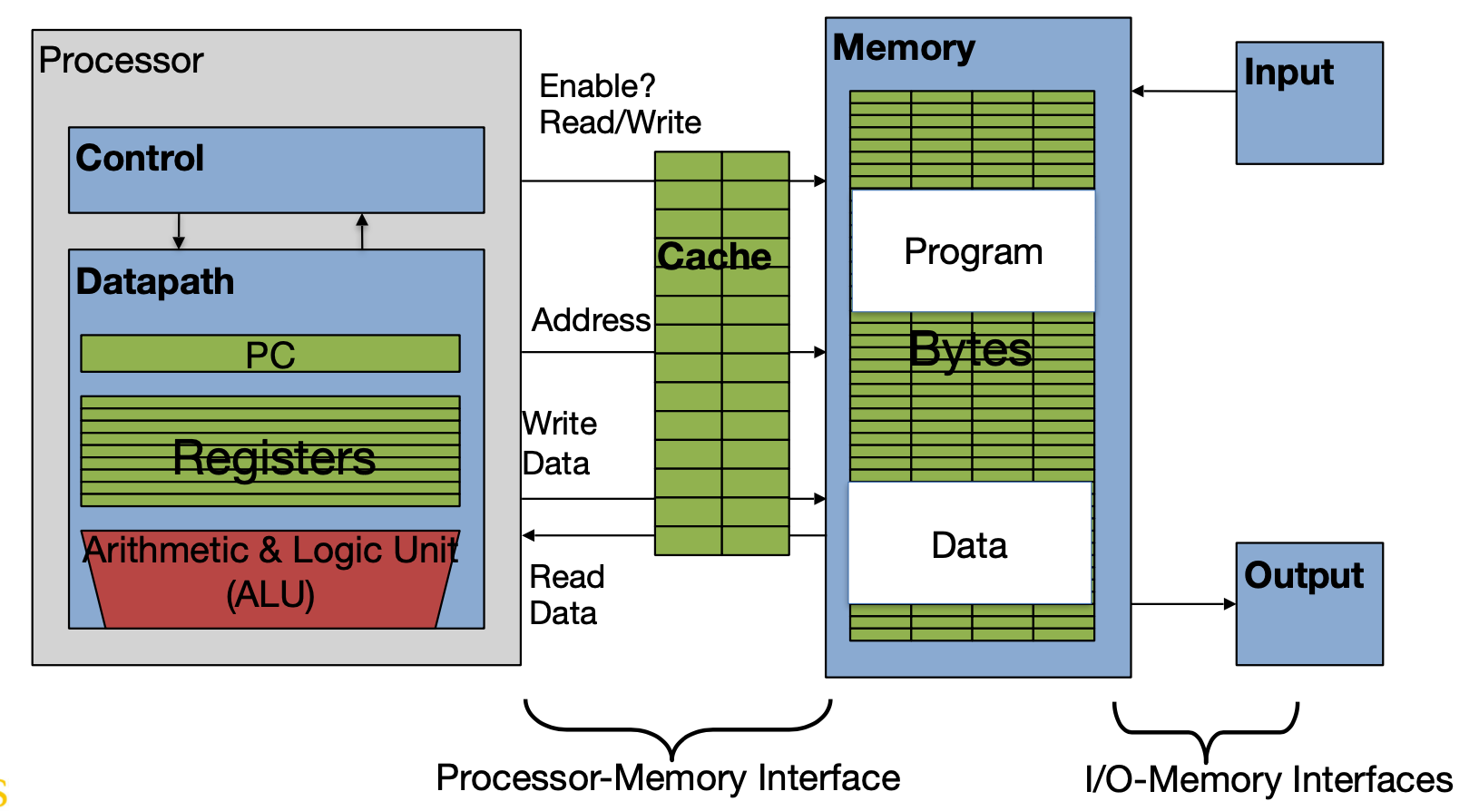
Adding Cache to Computer
Ref: Krste Asanović & Randy H. Katz, Univ of California, Berkeley

Slide 43
Memory Access with Cache
Load word instruction: lw t0,0(t1)
t1 contains 0x12F0, Memory[0x12F0] = 99
With cache:
Processor issues address 0x12F0 to Cache
Cache checks to see if has copy of data at address 0x12F0
If finds a match (Hit): cache reads 99, sends to processor
No match (Miss): cache sends address 0x12F0 to Memory
Memory reads 99 at address 0x12F0
Memory sends 99 to Cache
Cache replaces word which can store 0x12F0 with new 99
Cache sends 99 to processor
Processor loads 99 into register t0
Ref: Krste Asanović & Randy H. Katz, Univ of California, Berkeley

Slide 44
Cache Memory – Invisible to Programmers

Slide 45
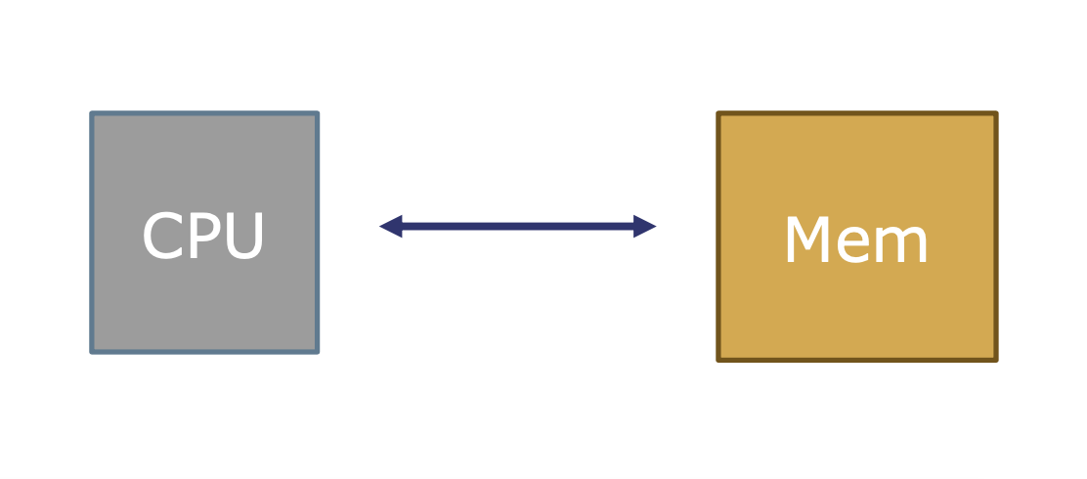
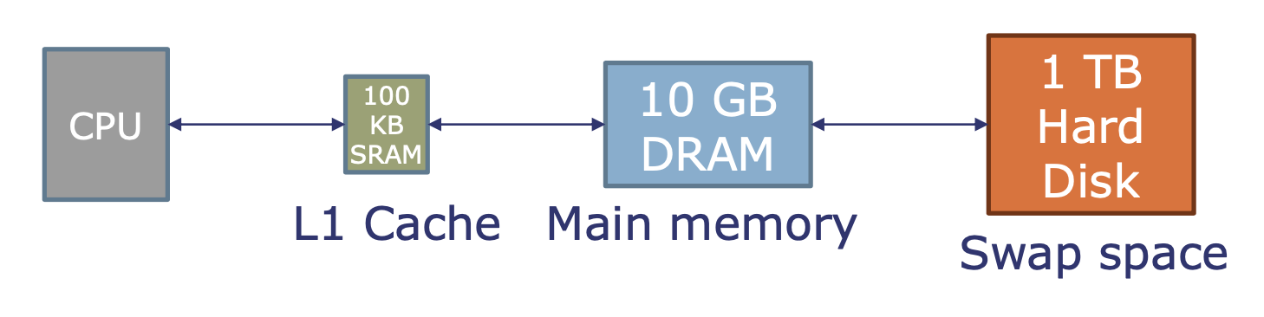
Memory Hierarchy Interface
Programming model: Single memory, single address space
Machine transparently stores data in fast or slow memory, depending on usage patterns
Ref: MIT Course 6.004 Computation Structures

Slide 46
Caches Concept (revision)
Cache: A smaller, faster storage device that acts as a staging area for a subset of the data in a larger, slower device.
Fundamental idea of a memory hierarchy:
For each k, the faster, smaller device at level k serves as a cache for the larger, slower device at level k+1.
Why do memory hierarchies work?
Because of locality, programs tend to access the data at level k more often than they access the data at level k+1.
Thus, the storage at level k+1 can be slower, and thus larger and cheaper per bit.
Big Idea (Ideal): The memory hierarchy creates a large pool of storage that costs as much as the cheap storage near the bottom, but that serves data to programs at the rate of the fast storage near the top.
Bryant and O’Hallaron, Computer Systems: A Programmer’s Perspective, Third Edition

Slide 47
Quiz
Instructions generally have spacial and temporal locality.
Which of the following statement is not true?
The first time a function with no loops executes the processor can take advantage of spacial locality
The first time a function with no loops executes the processor can take advantage of temporal locality
The first time a function with loops executes the processor can take advantage of spacial locality
The first time a function with loops executes the processor can take advantage of temporal locality
Ref: Krste Asanović & Randy H. Katz, Univ of California, Berkeley

Slide 48
Quiz
Instructions generally have spacial and temporal locality.
Which of the following statement is not true?
The first time a function with no loops executes the processor can take advantage of spacial locality
The first time a function with no loops executes the processor can take advantage of temporal locality
The first time a function with loops executes the processor can take advantage of spacial locality
The first time a function with loops executes the processor can take advantage of temporal locality
Ref: Krste Asanović & Randy H. Katz, Univ of California, Berkeley

Slide 49
Class Summary
Present to the programmer as much memory as the largest memory at the speed of the fastest memory
Approach: Memory Hierarchy
Successively higher levels contain “most used” data from lower levels
Exploits temporal and spatial locality
Cache is Programmer-invisible hardware mechanism to give illusion of speed of fastest memory with size of largest memory

Slide 50
Backup Slides

Slide 51
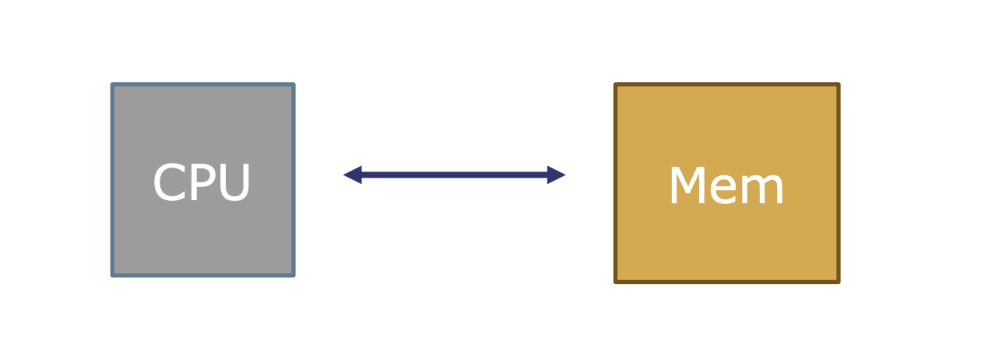
Cache Philosophy - Interface
Programming model: Single memory, single address space
Ref: MIT Course 6.004 Computation Structures

Slide 52
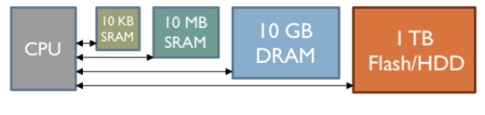
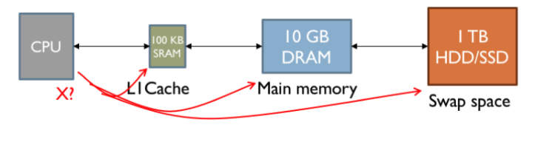
Cache Philosophy - Interface
Approach 1: Expose Hierarchy
Registers, SRAM, DRAM, Flash, Hard Disk
Tell programmer to “use them cleverly”
Approach 2: Hide Hierarchy
Programming model: Single memory, single address space
Machine transparently stores data in fast or slow memories depending on usage patterns
Ref: MIT Course 6.004 Computation Structures

Slide 53
Modern processors have separate caches for instructions and data, as well as several levels of caches implemented in different sizes

Slide 54
Qualitative Estimates of Locality
Claim: Being able to look at code and get a qualitative sense of its locality is a key skill for a professional programmer.
Question: Does this function have good locality with respect to array a?
int sum_array_rows(int a[M][N])
{
int i, j, sum = 0;
for (i = 0; i < M; i++)
for (j = 0; j < N; j++)
sum += a[i][j];
return sum;
}
Hint: array layout is row-major order
Answer: yes
• • •
a
[0]
[0]
a
[0]
[N-1]
• • •
a
[1]
[0]
a
[1]
[N-1]
• • •
• • •
a
[M-1]
[0]
a
[M-1]
[N-1]
Bryant and O’Hallaron, Computer Systems: A Programmer’s Perspective, Third Edition

Slide 55
Locality Example
Question: Does this function have good locality with respect to array a?
int sum_array_cols(int a[M][N])
{
int i, j, sum = 0;
for (j = 0; j < N; j++)
for (i = 0; i < M; i++)
sum += a[i][j];
return sum;
}
Answer: no, unless…
M is very small
• • •
a
[0]
[0]
a
[0]
[N-1]
• • •
a
[1]
[0]
a
[1]
[N-1]
• • •
• • •
a
[M-1]
[0]
a
[M-1]
[N-1]
Bryant and O’Hallaron, Computer Systems: A Programmer’s Perspective, Third Edition

